Slide 1

Safety floater
IoT group project for coastal tourism
Blue Growth
Daniele Bufalieri, Marco Calamo, Ivan Giacomoni

Slide 2
What is the problem?
The problem is the security of swimmers because of the boats that do not respect the safety distance from the coast.
It is a threat for the tourists and also for the environment because the pollution near the shore.
There is not a direct communication to the authorities

Slide 3
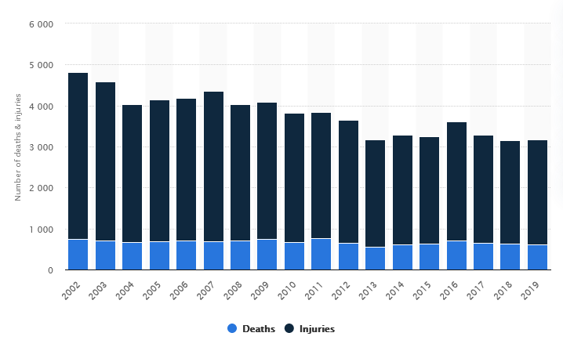
Boat accidents FROM 2002 TO 2019

Slide 4
Key functionalities
Real time reporting to authorities of violations
Create a safer holiday for tourists
Improve water quality near the shore
Decrease number of accidents
Provide an user friendly dashboard in order to monitor violations

Slide 5
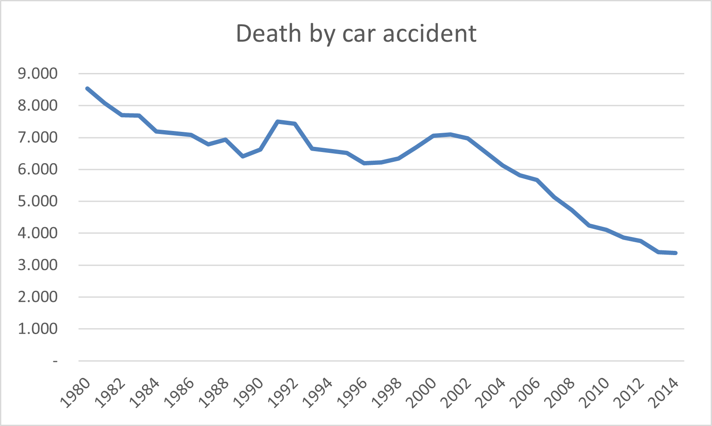
Collective intelligence
Our purpose is to replicate this trend of death by car accident since autovelox was introduced, but in the context of accident caused by boats introducing our system in order to prevent an increasing number of deaths.

Slide 6
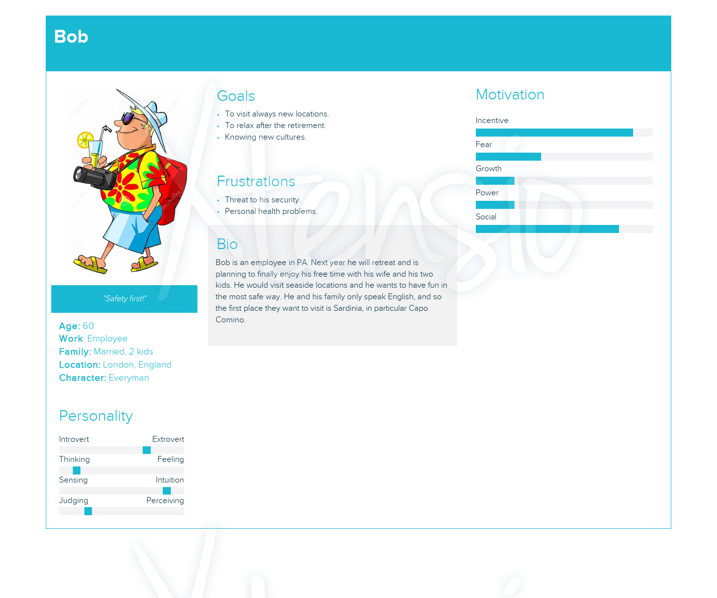
User Personas: bob
Wants to meet new cultures
Wants to visit new locations
Wants to relax after the retirements
with his family
He is an employee in PA
Likes to feel secure

Slide 7
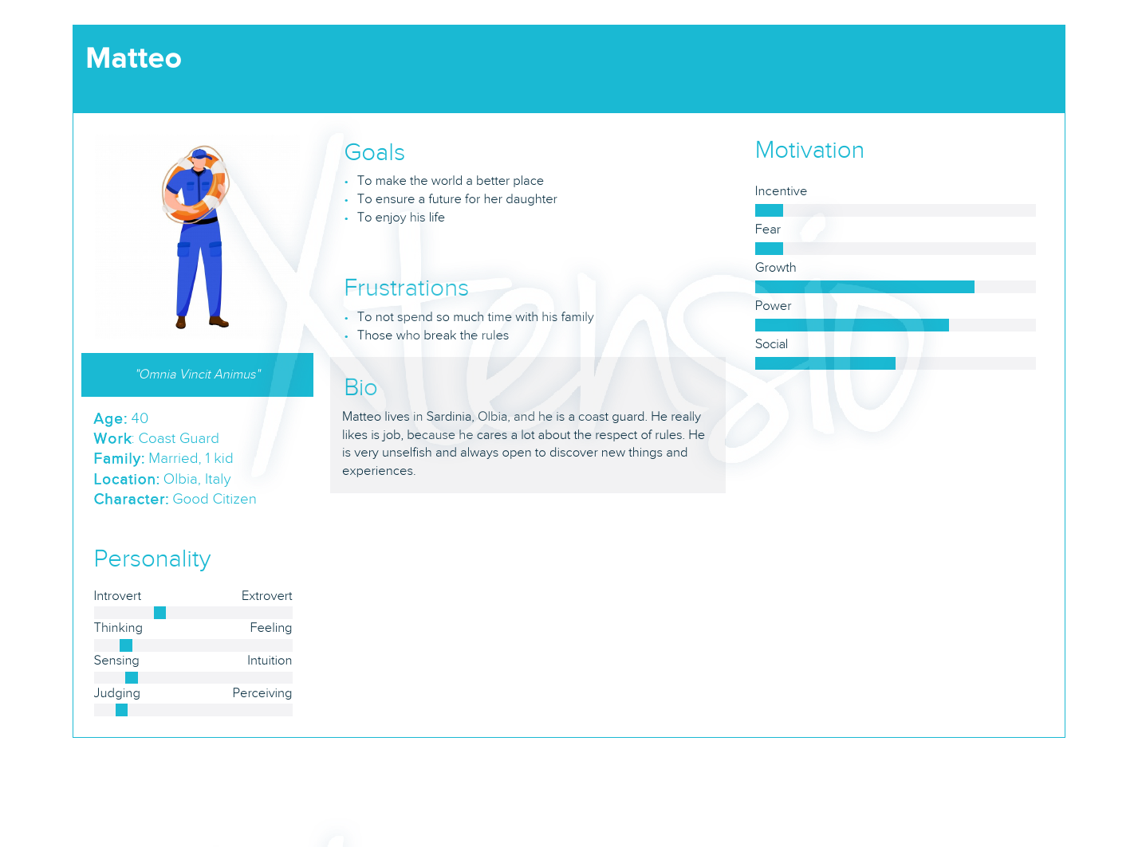
User Personas: matteo
Lives in Sardinia
His job is coast guard
Cares a lot about the respect of rules
Wants to make a world a better place
Wants to enjoy his life

Slide 8
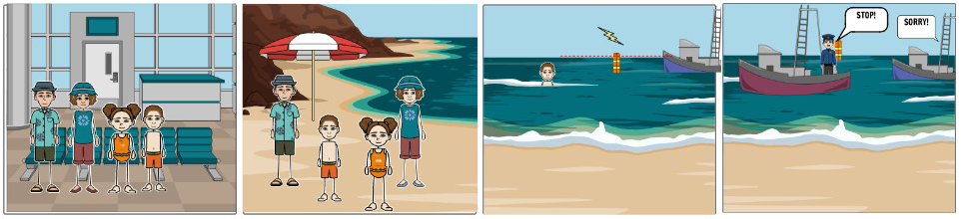
Scenarios
Bob is in Sardinia with his family on vacation. One day, his son is swimming in the water nearby, Bob sees a boat approaching too close to safety line, but thanks to the Safety Floater system control his son is not really in danger, because authorities will intervene in time.

Slide 9
Iot architecture
LoraWAN
MQTT
MQTT
Safety Floater
Sea Station
Cloud Server
Frontend
REST

Slide 10
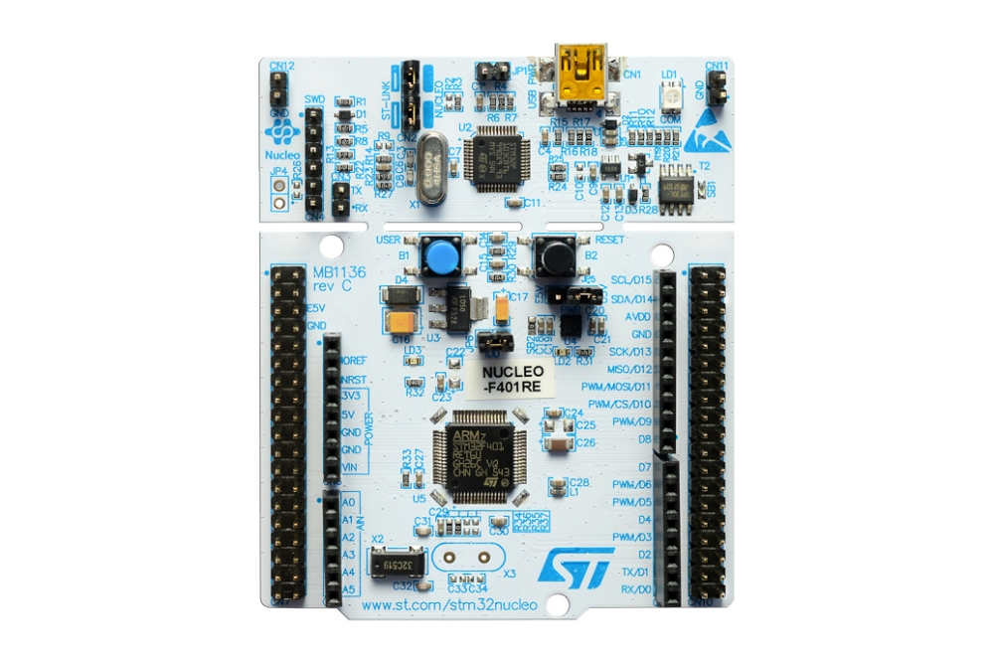
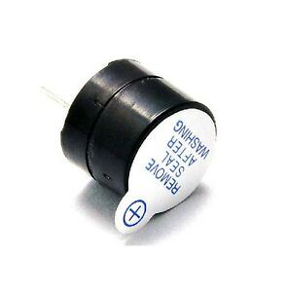
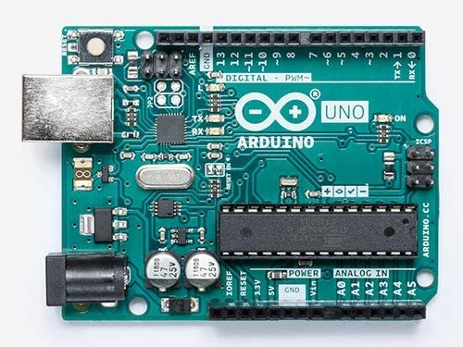
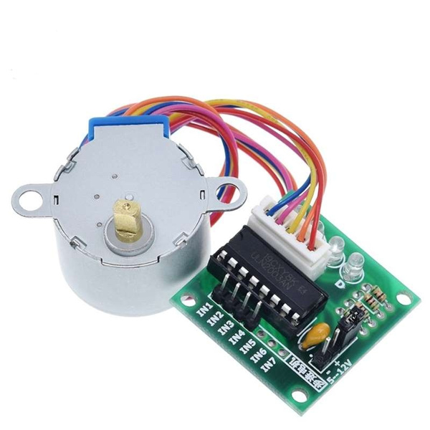
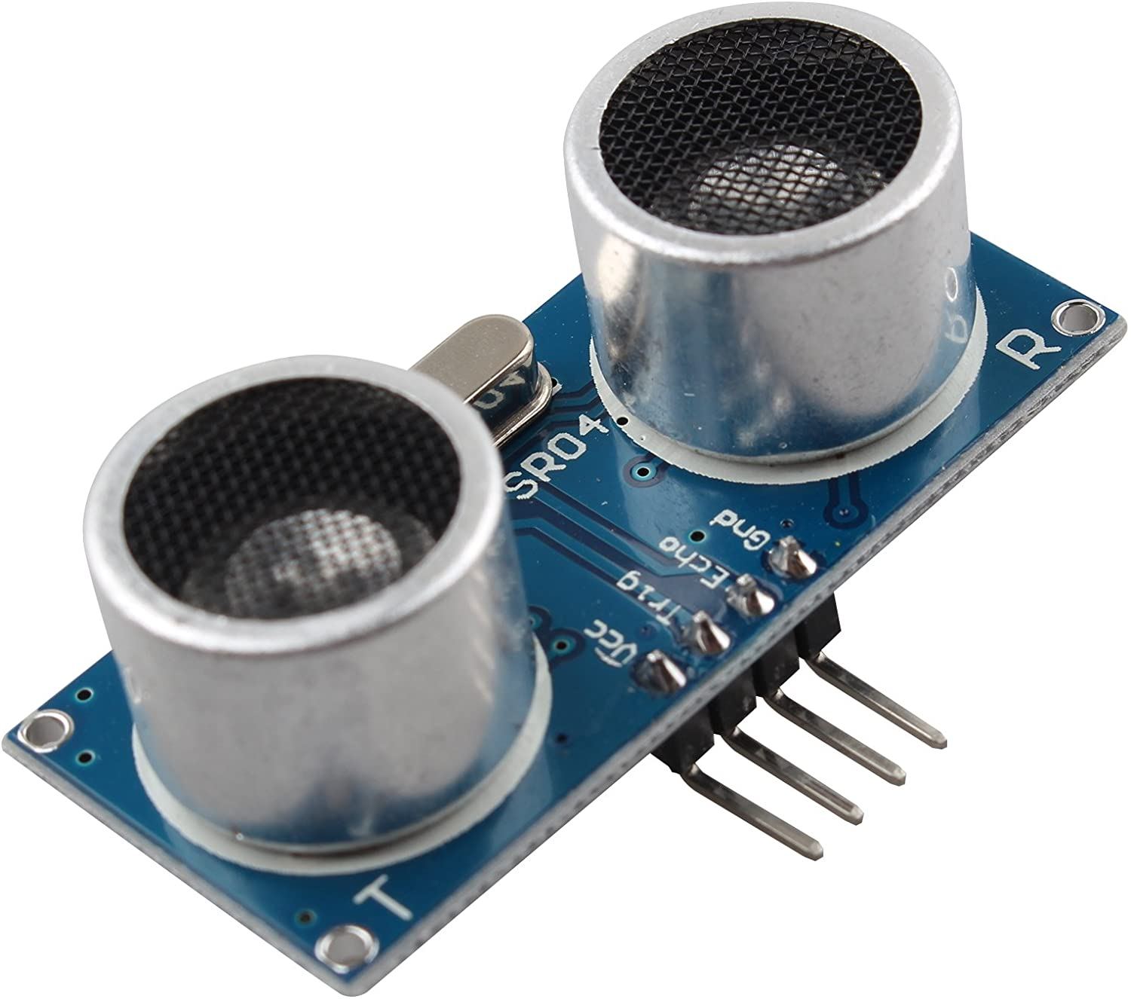
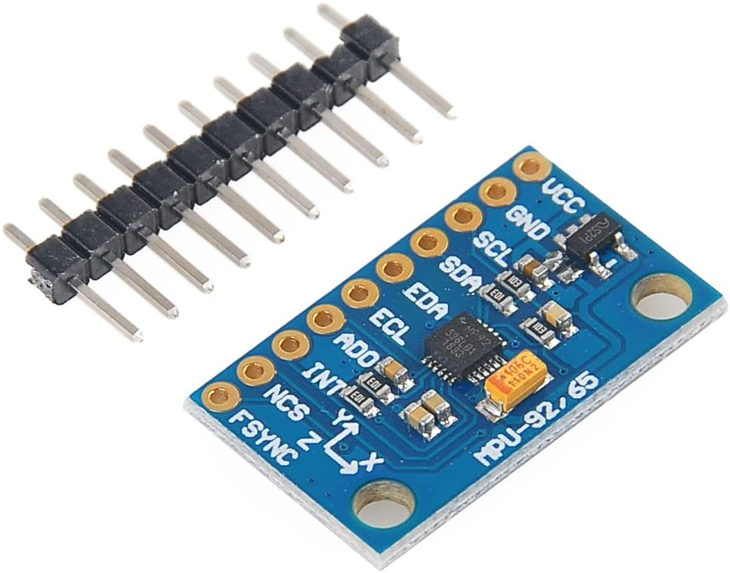
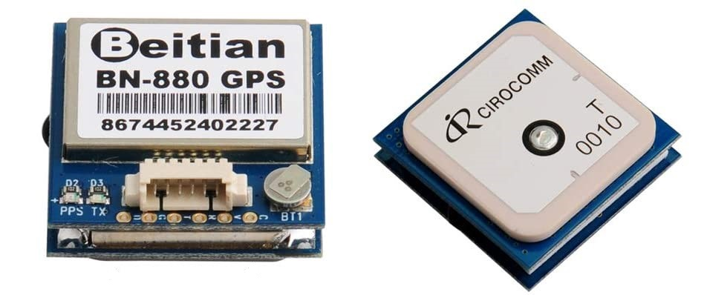
safety floater: Sensors & Actuators
Buzzer
Gyroscope
Stepper
Proximity Sensor
GPS

Slide 11



safety floater: structure & Communication
MASTER
SLAVE
TO SEA STATION
NUCLEO F401RE
ARDUINO UNO

Slide 12

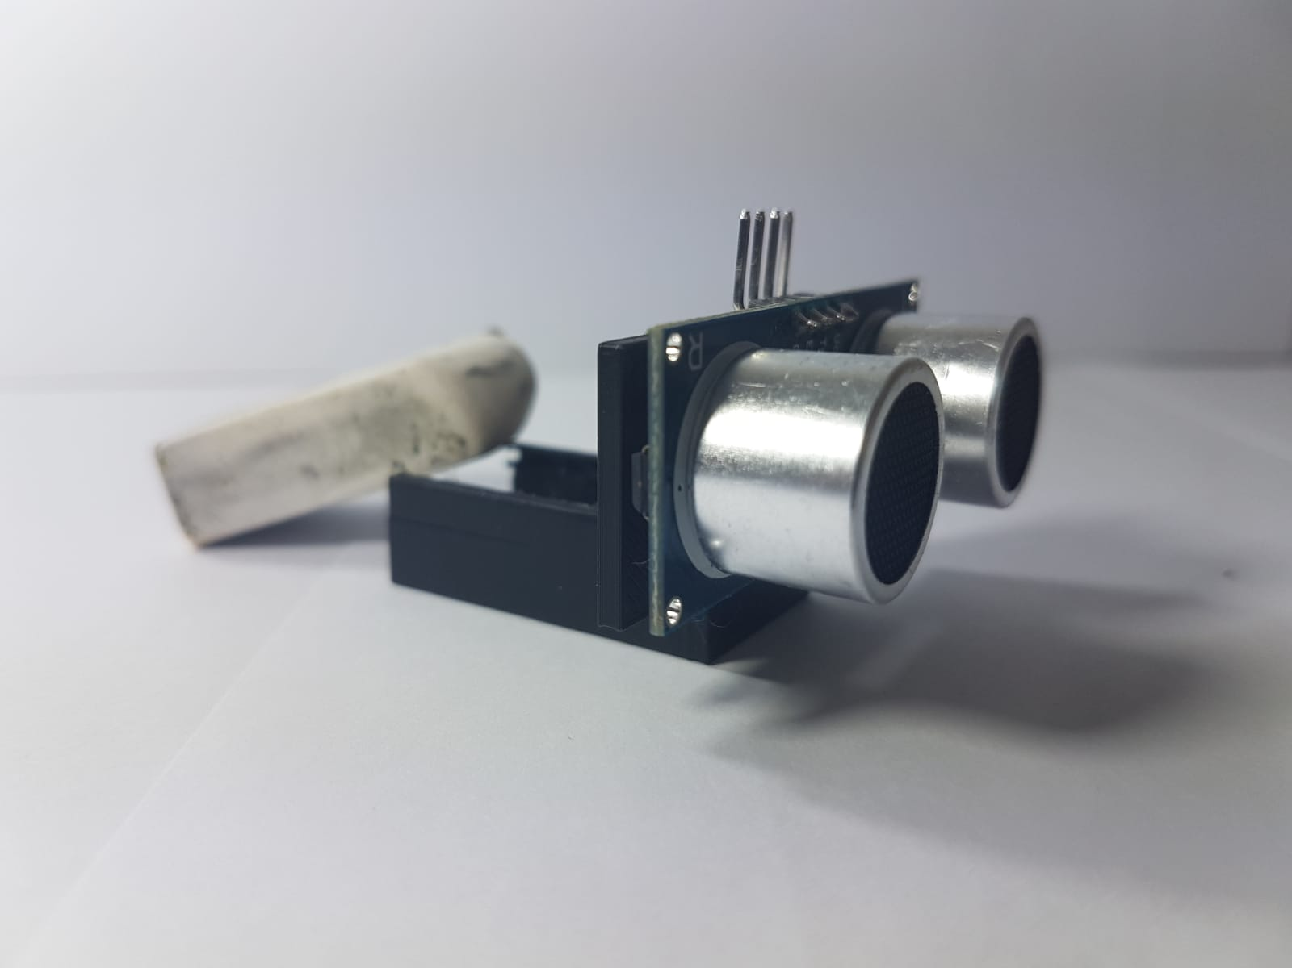
safety floater: SPOTTER
On the front side, it’s installed the proximity sensor
In the hole, it’s installed the gyroscope
On the bottom there is a hole to lock on the spotter on the stepper
This system is used to guarantee the correct orientation of the proximity sensor in order to have better possibilities to detect boats
P.S. It’s designed and 3D printed by us ;)

Slide 13
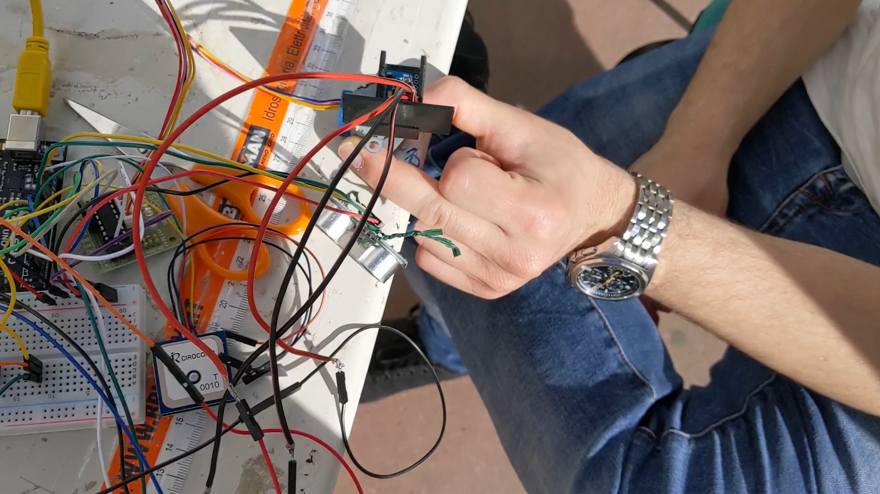
SAFETY FLOATER: FUNCTIONALITIES
Boat detection mechanism
Orientation control mechanism
Power management mechanism
System info mechanism
Sea-ground communication system

Slide 14
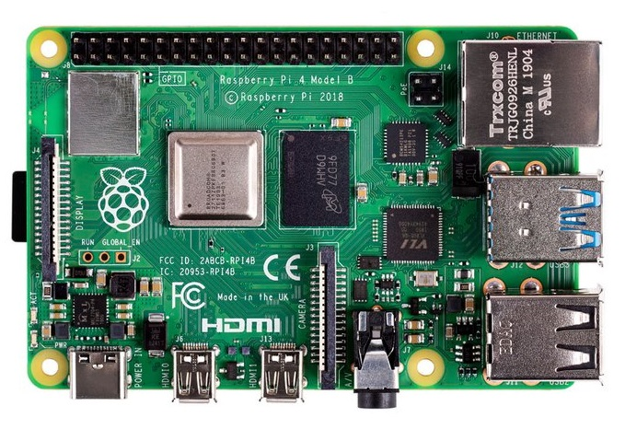

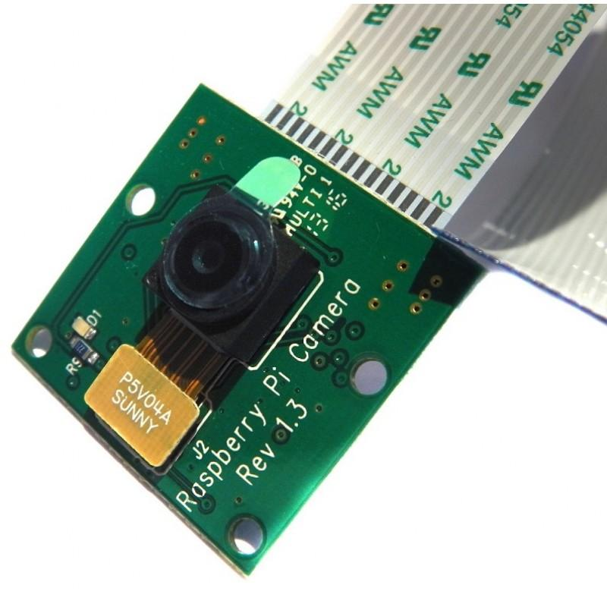
Sea station: structure & Communication
RASPBERRY PI 4
FROM SAFETY FLOATER
TO AWS
CLOUD
CAMERA

Slide 15
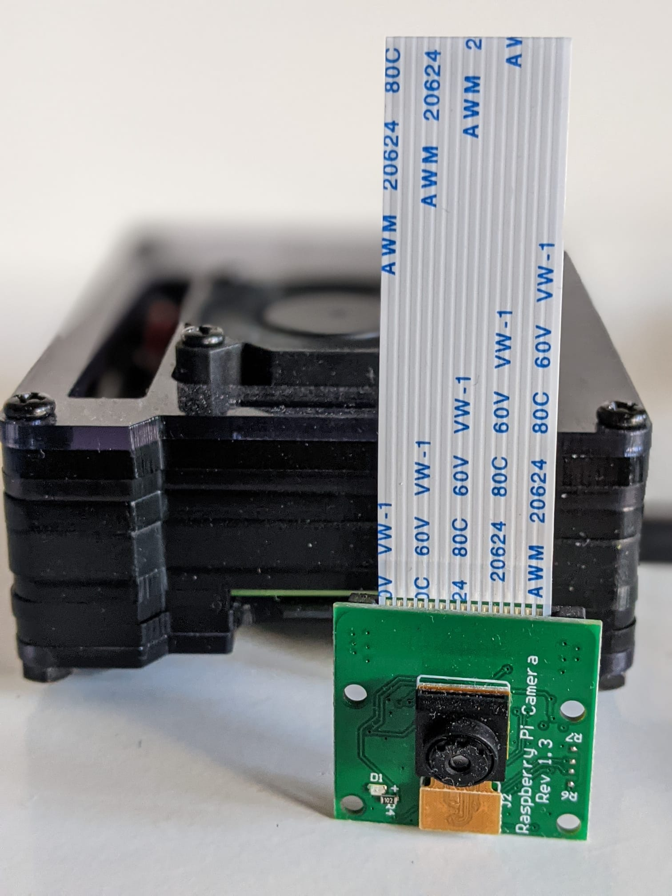
SEA STATION: FUNCTIONALITIES
Ground-sea communication
Boat recognition system
Ground-cloud communication

Slide 16
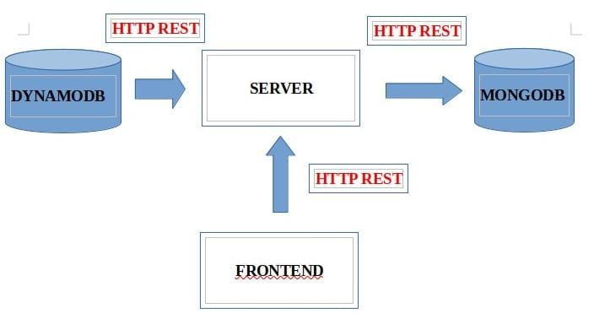
CLOud server & FRONTEND: structure

Slide 17
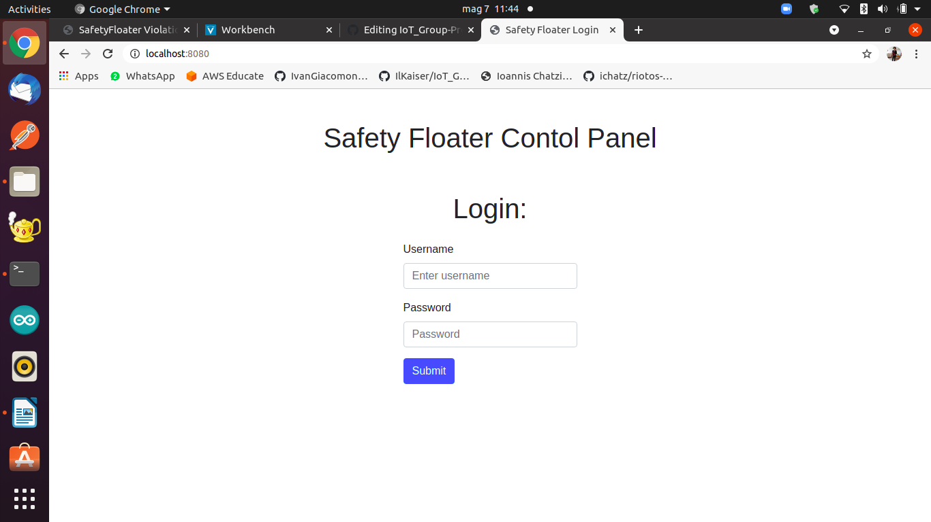
CLOud server & FRONTEND: FUNCTIONALITIES

Slide 18
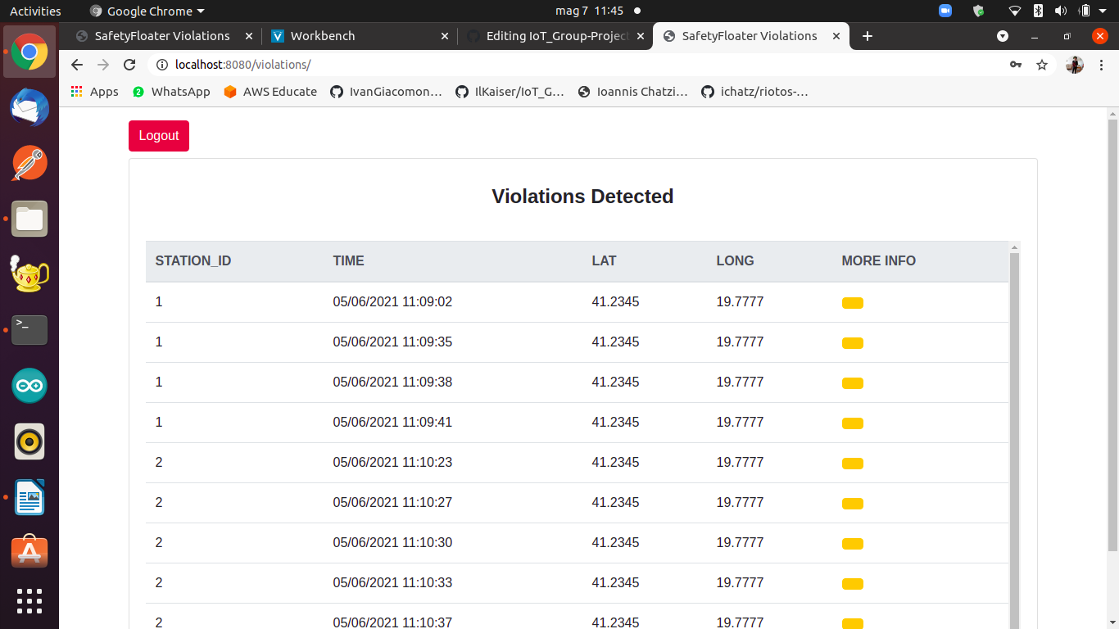
CLOud server & FRONTEND: FUNCTIONALITIES

Slide 19
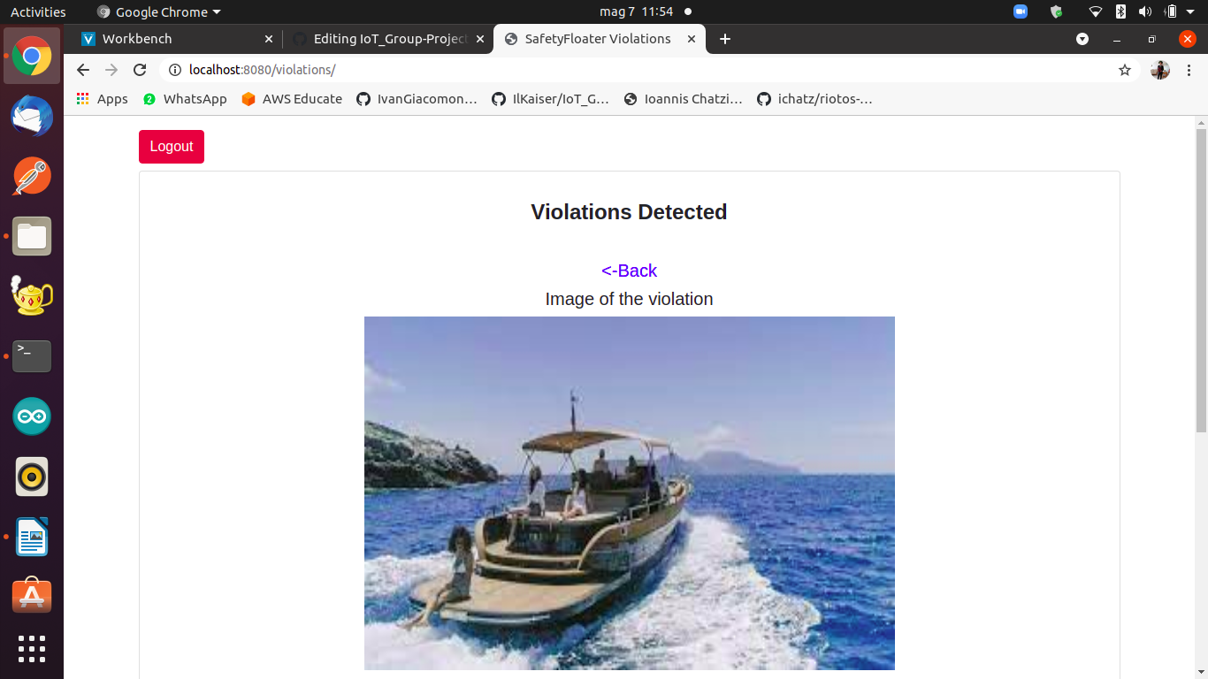
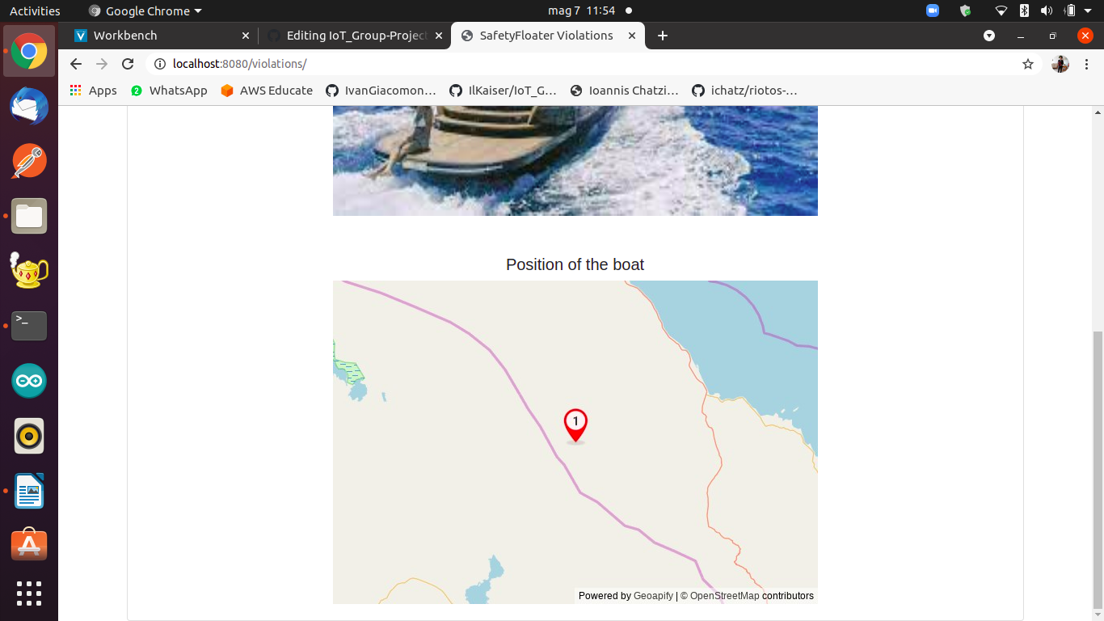
CLOud server & FRONTEND: FUNCTIONALITIES
1

Slide 20
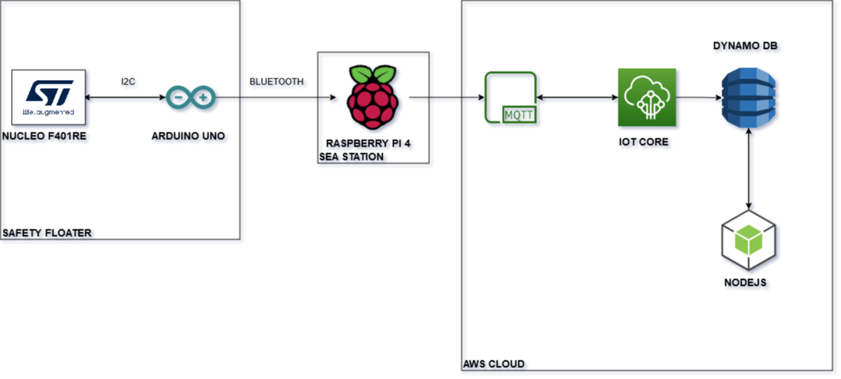
IOT ARCHITECTURE: DETAILED SUMMARY

Slide 21
Constraints
All sensors are constantly sampled
Bandwith and latency limitated by the capacity of LoraWAN
Waterproof sensors
Energy is a key factor in Safety Floater, we use solar panel in order to increase the battery life
Power consumption reduced at minimum

Slide 22
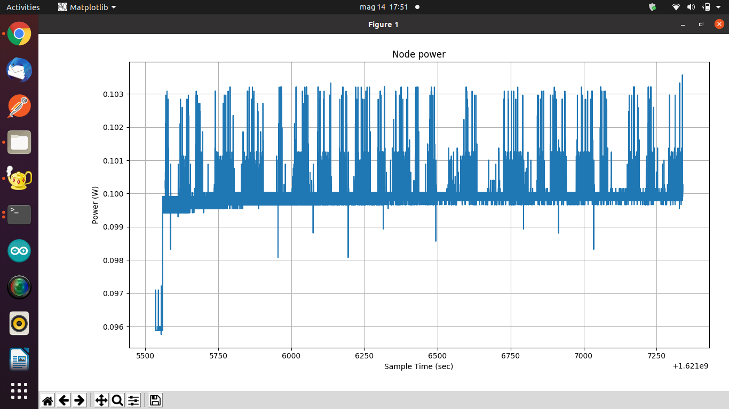
Evaluation & PERFORMANCE: power consumption mode 1

Slide 23
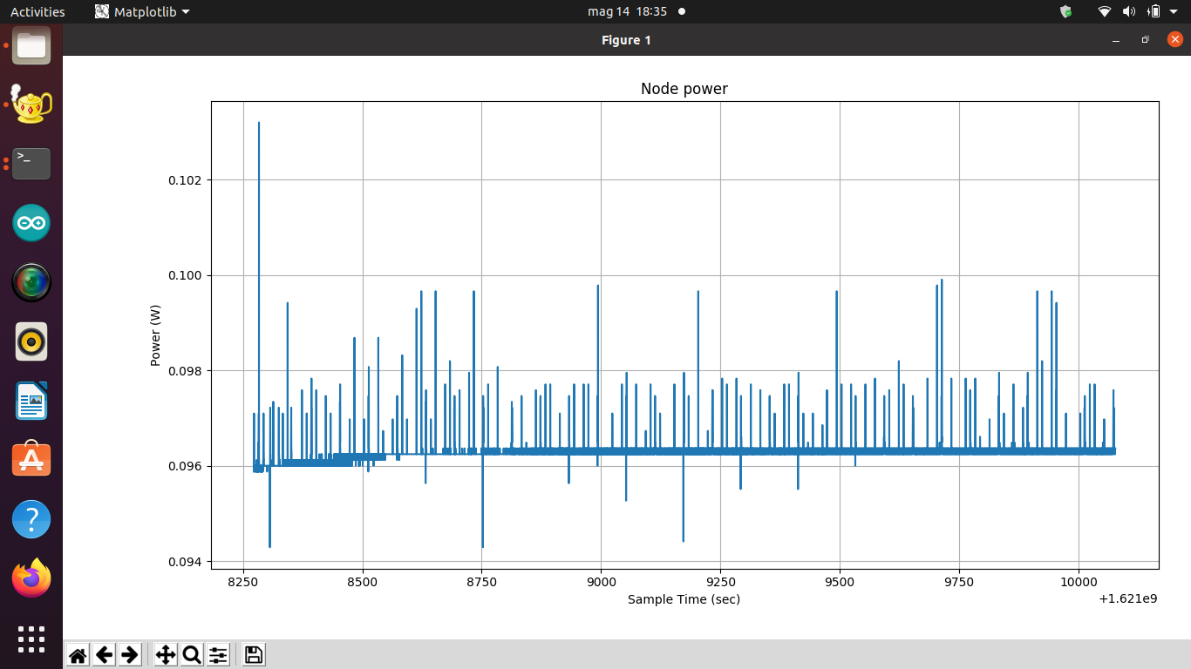
Evaluation & PERFORMANCE: power consumption mode 2

Slide 24
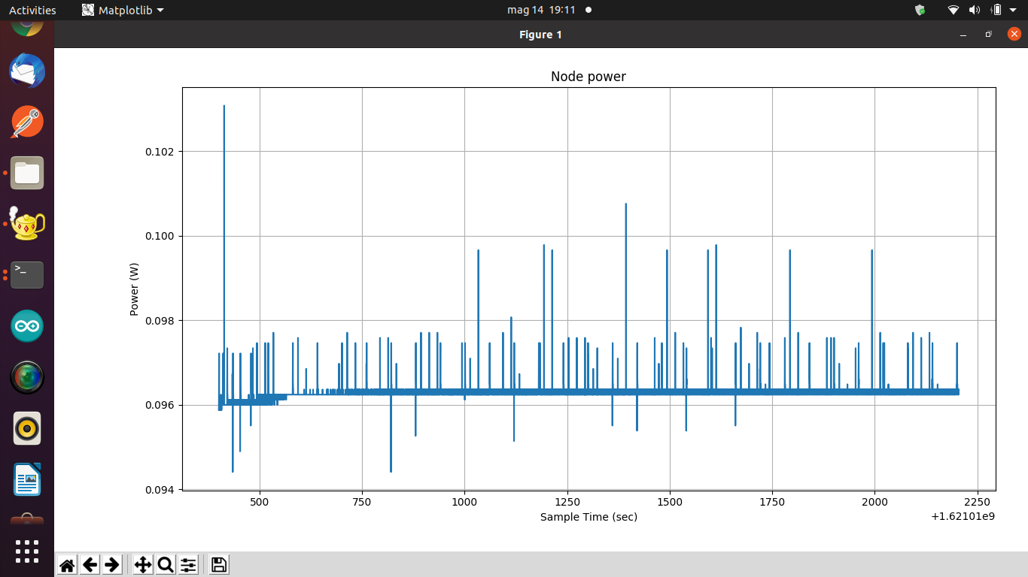
Evaluation & PERFORMANCE: power consumption mode 3

Slide 25
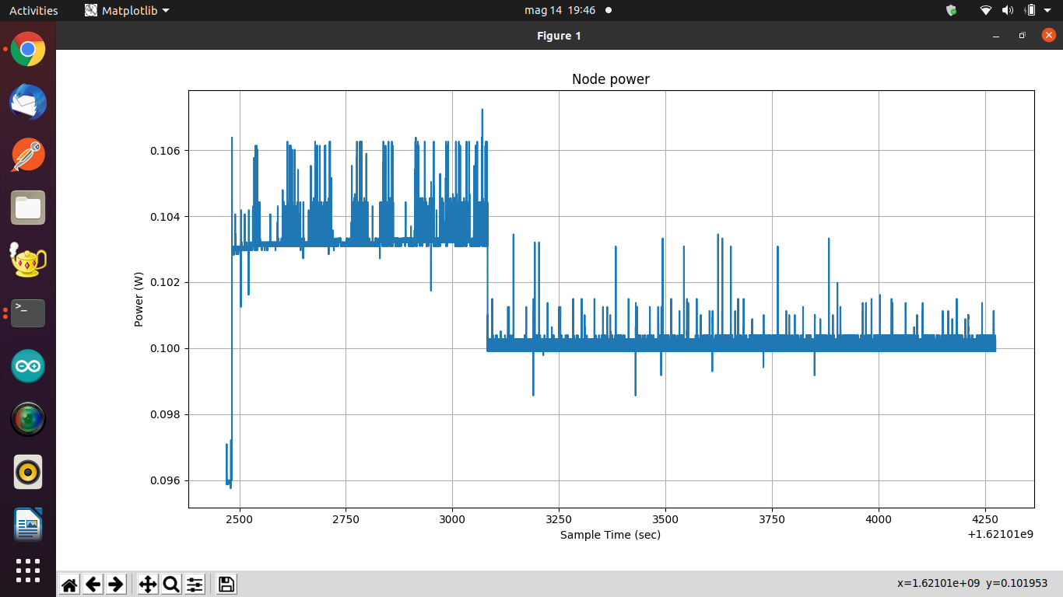
Evaluation & PERFORMANCE: power consumption general

Slide 26
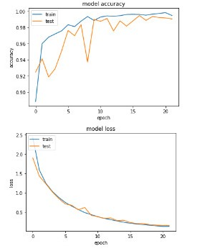
Evaluation & PERFORMANCE: boat detection

Slide 27
Evaluation & PERFORMANCE: NETWORK latency
I2C: STM->ARDUINO (0.001 S)
BLUETOOTH: ARDUINO->RASPBERRY (0.150 S)
PHOTO: RASPBERRY (3.000 S)
MQTT: RASPBERRY->CLOUD (0.050 S)
REST: CLOUD ->NODE (0.050 S)
REPORT AVAILABLE ON THE DASHBOARD (4.255 S)
I2C: STM->ARDUINO (0.001 S)
I2C:ARDUINO->STM(0.001 S)
Delay to detect false positive 1.000 S
I2C: STM->ARDUINO (0.001 S)
I2C:ARDUINO->STM (0.001 S)
BUZZER ACTIVATED (1.004 S)

Slide 28
Future development
Optimizing power management
Improving latency
Development of a better web interface
Introduction of Solar panel
Security
Use a better gyroscope, if possible

